Slide 1
A Methodology for Encoding
Mensural Music:
Introducing the Mensural MEI Translator
Karen Desmond, Brandeis University
Martha E. Thomae, McGill University
Music Encoding Conference
Tours, May 17th, 2017

Slide 2
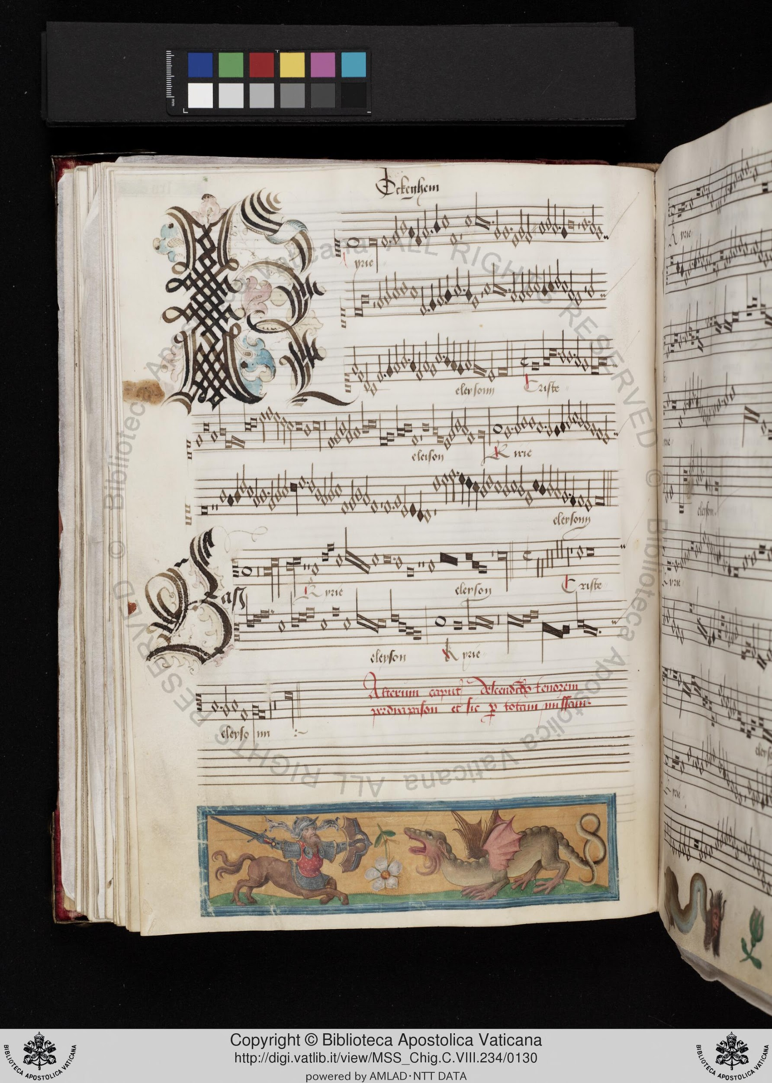
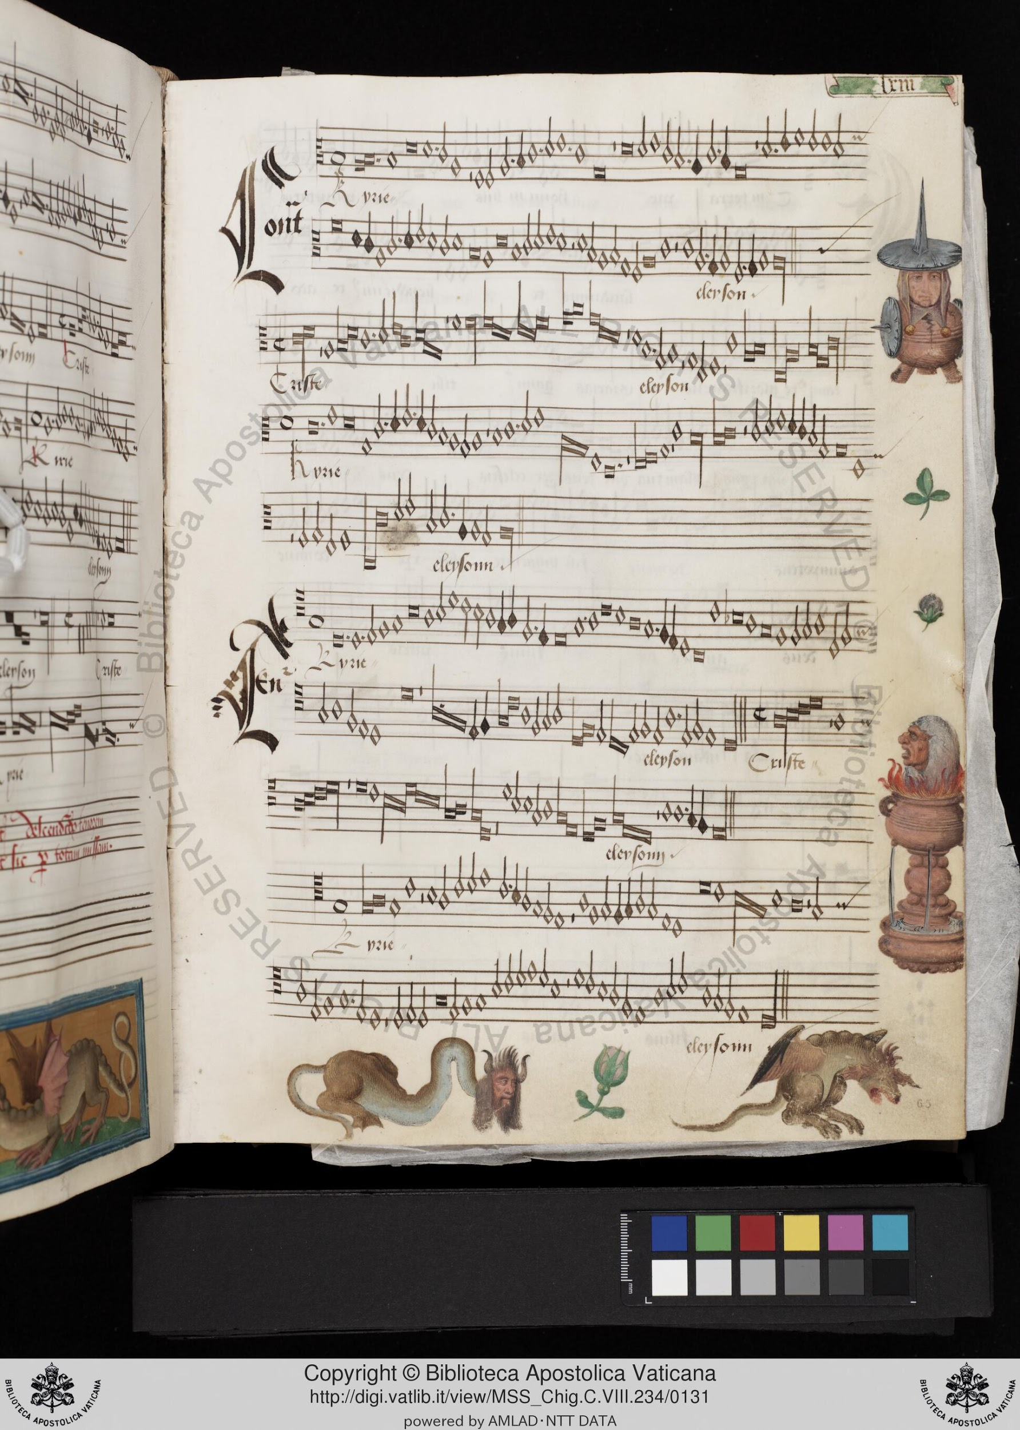
Notes:
Music from the Late Middle Ages and Renaissance
Music written mensural notation
To encode this music in a machine-readable format that encoded its original (mensural) values
Very few formats that provide support for mensural notation
One of them is MEI (Mensural MEI)
Goal: encode these pieces into Mensural MEI files
Hand-coding → inefficient
Duration is context-dependent
Interpretation while coding

Slide 3
And how can we get them encoded into Mensural MEI files?
What is the best way to get musicologists to enter a large amount of musical documents into the computer?
Notes:
In this paper we present a methodology that accomplishes this task, in part through a tool we developed called

Slide 4
The Mensural MEI Translator
Notes:
The Mensural MEI Translator.

Slide 5
A straightforward method to encode music repertories from the later Middle Ages and the Renaissance
as they were originally notated.
Notes:
Which offers a straighforward . . . (click for last phrase of sentence to appear). This methodology allows musicologists to use a score editor that they are already familiar with (i.e. Sibelius), and then this file is submitted through a couple of processes to convert it into mensural MEI. However, before explaining how the translator works, for a few of you anyway, perhaps a quick refresher of mensural notation would be useful.

Slide 6
Mensural Notation 101

Slide 7
Mensural Notation
System of notation used from the 1250s to 1600s
Looks similar to our common Western music notation (CMN):
Already uses staff-lines and clefs to indicate pitch
Mensural note-shapes are similar to CMN note-shapes
Modern Notes
(White) mensural notes
Notes:
In the second half of the thirteenth century techniques for specifically indicating rhythmic duration were developed, a notation called ‘mensural’ or ‘measurable.’ Almost all polyphonic music from 1300-1600 is notated in mensural notation, the rules of which changed little from c. 1350.

Slide 8
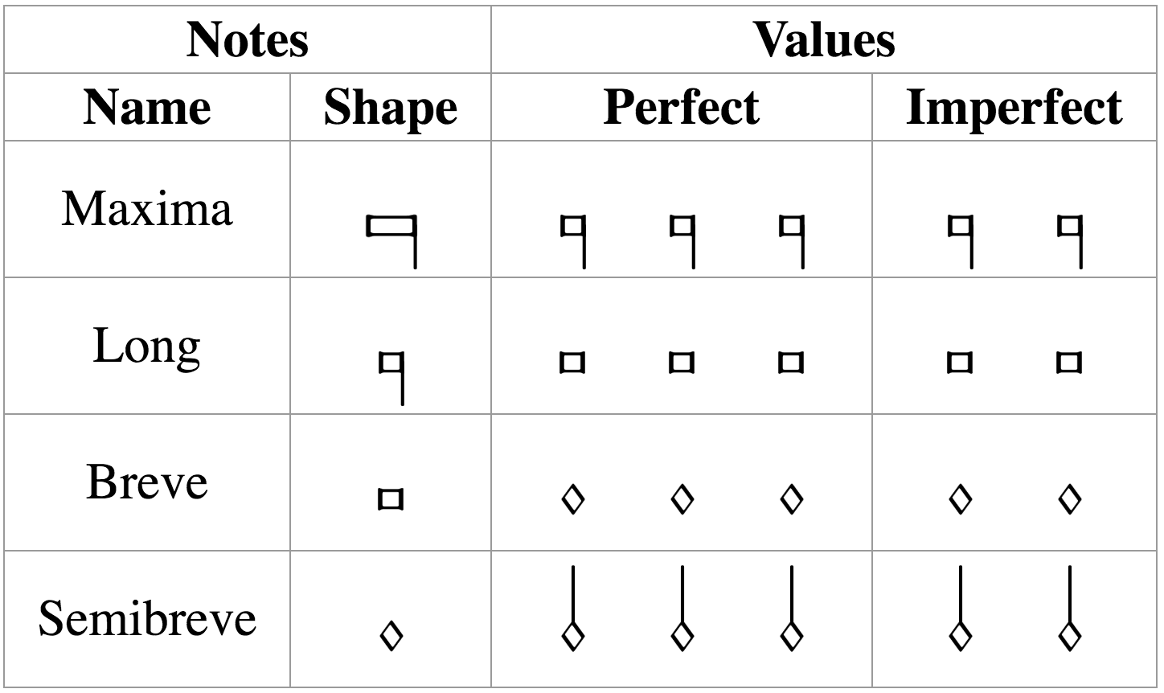
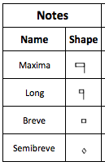
Mensural Notation
The note-shapes are similar and there is a clear hierarchy in the note duration
longest
But, the actual value of these notes is ambiguous
shortest
It can either be triple (i.e., “perfect”) or duple (i.e., “imperfect”)
The value is determined by two factors:
Mensuration
Context
Notes:
[third bullet] Mention: “perfect” for the Holy Trinity (so people remember the terms “perfect” and “imperfect”
[SAME, end of third bullet] In the same piece, moreover, in the same voice, the same note can be used with two different values
[Mensuration] IT WILL TELL YOU BY DEFAULT THE VALUE OF THOSE FOUR NOTES, WHETHER IT WILL BE PERFECT OR IMPERFECT
[Context] EXCEPTIONS TO THAT DEFAULT VALUE
There are certain principles on how context affects the note value. I am not going to enumerate all of these principles, but I will give an example of the general idea of on how these principles work.

Slide 9
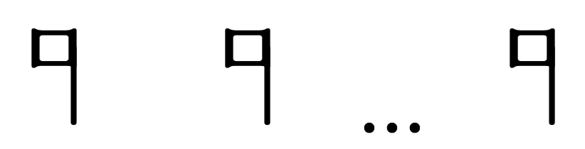
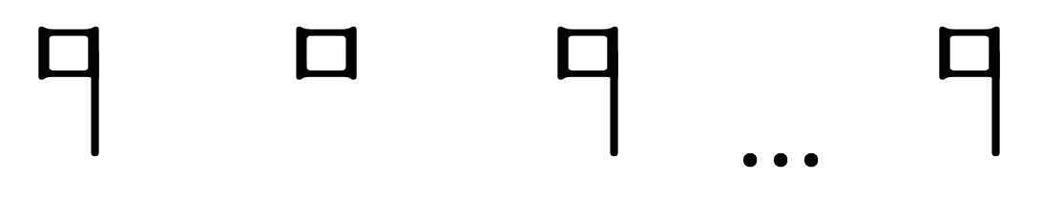

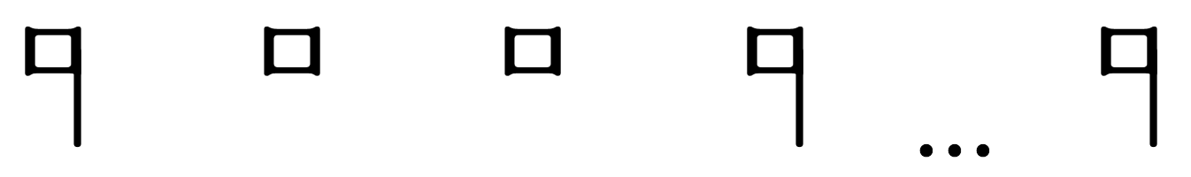

Examples of Context Changing the Note’s Value
Mensuration: modus (longs) = 3 → Longs are perfect by default
Perfect → Imperfect
Alteration
x 2
Notes:
Modus = 3 → mensuration for the long, the default value of the long is perfect
Long + long
Long + Breve + Long
Long + Breve + Breve + Long
During the course of this presentation, I will point out some of these peculiarities
Maybe I overgeneralized certain things, but this is just an introduction to mensural notation, and the important thing I want you to understand is that
There is no one-to-one correspondence between note shape and note value
The default value of a note is given by the mensuration, i.e., it says if a note is either ‘perfect’ or ‘imperfect’ by default
And the context can modify this value,
can switch it from perfect to imperfect (or viceversa), that is one kind of modification
or can double the note value, which is the another kind of modification called “alteration”

Slide 10
Methodology for Encoding
Mensural Music
Notes:
So, back to our proposed methodology for encoding mensural music

Slide 11
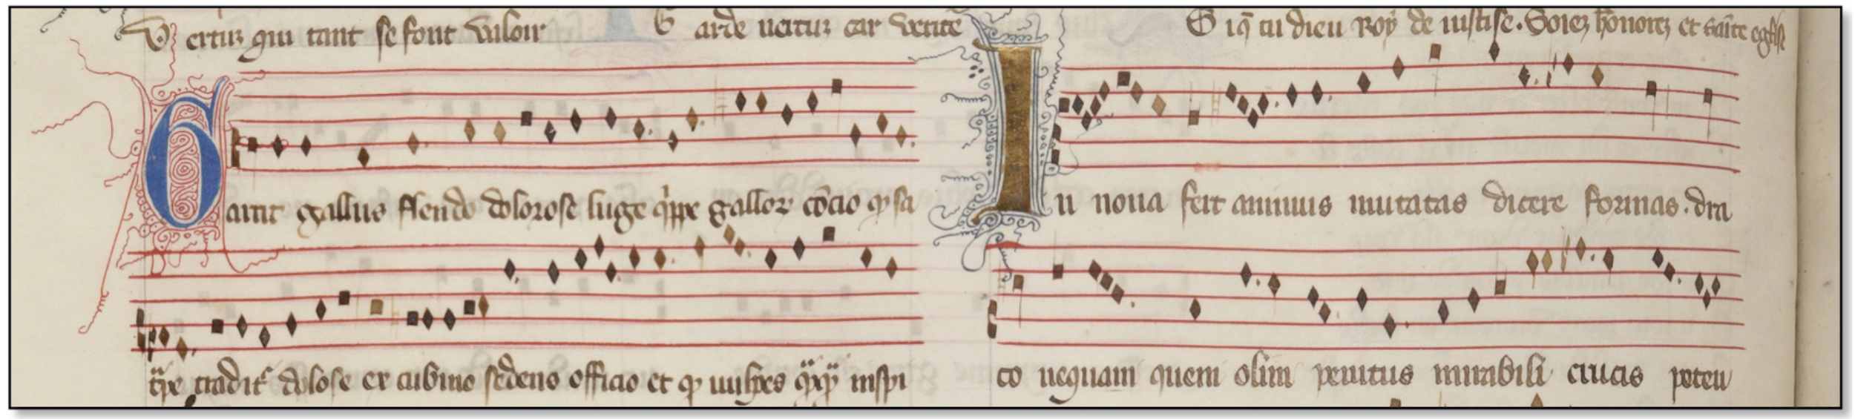
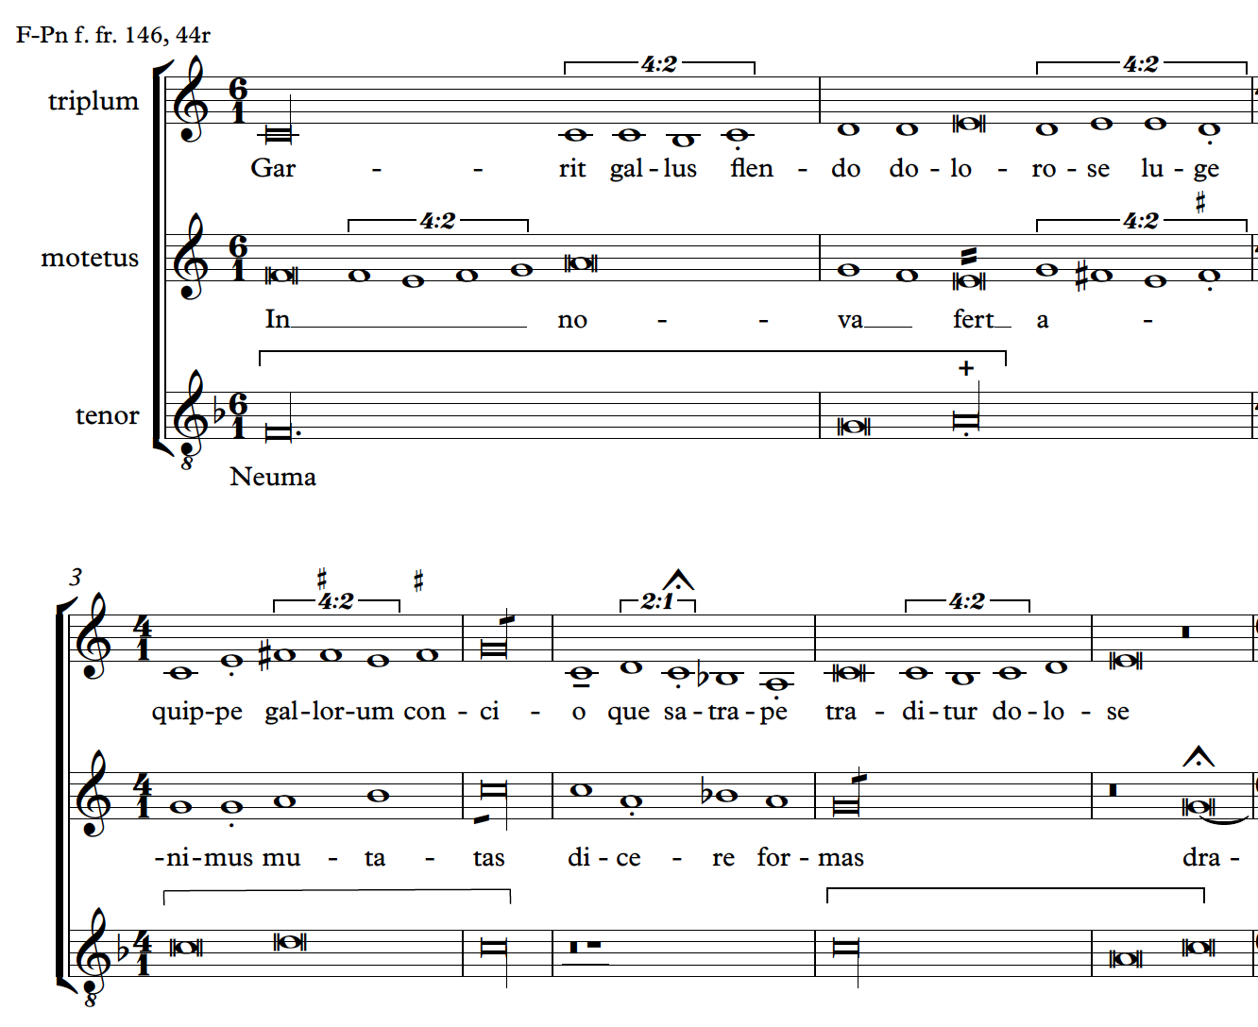
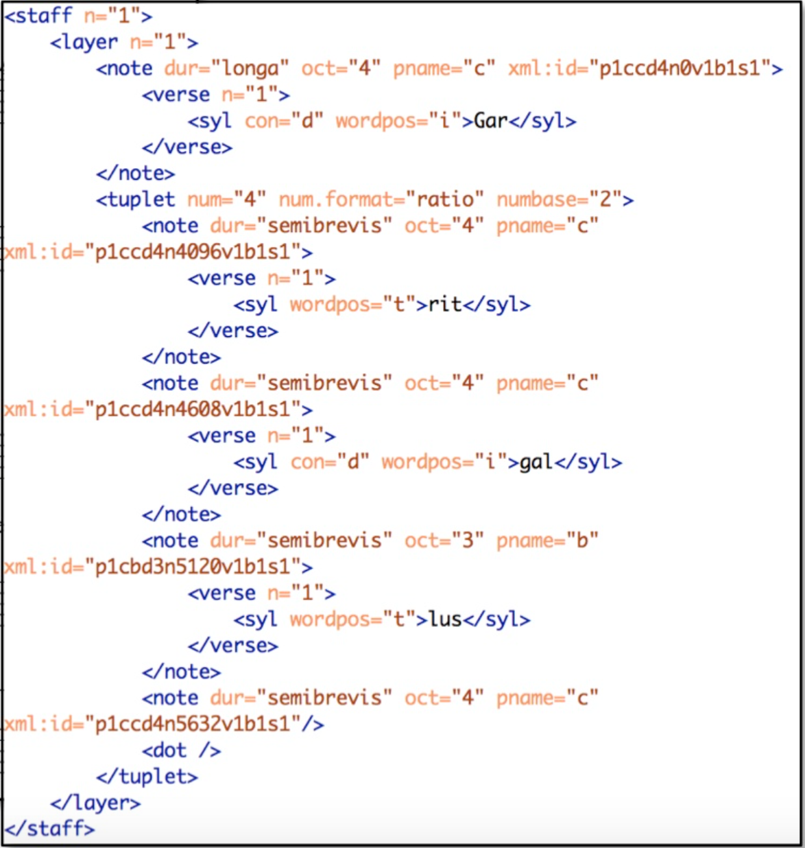
Methodology
Mensural MEI
Document
Common Music Notation MEI
Opening of the motet Garrit gallus / In nova from the manuscript Paris, Bibliothèque nationale, f. fr. 146.

Slide 12


Methodology
Sibelius
file
(modern transcription)
CMN
MEI
file
Mensural
MEI
file
SibMEI
plugin
Mensural MEI
Translator
Notes:
Richars Freeman, Lost Voices Project?

Slide 13
Step 1: Transcribe
Sibelius
file
(modern transcription)
Modern transcriptions usually do not record all the features contained in the mensural sources
We developed a system of articulation marks to represent specific mensural notation features in the Sibelius transcriptions
Notes:
Imperfect long and altered breve, have the same duration (they are worth two breves). Thus, in the modern transcription, both notes will look the same; although they are two different notes and they are represented by two different note shapes in the original source.
The dots (of division or augmentation) have an effect on the duration of a note, the effect is recorded in the modern transcriptions, but the presence of the dot itself is not.
…
All these articulation marks in the Sibelius file will be encoded in the CMN MEI file, and then they will be decoded by the ‘Translator’ into the corresponding elements/attributes in the Mensural MEI file. Thus, we will have a Mensural MEI file that faithfully represents what was written in the original manuscript.
Richars Freeman, Lost Voices Project?

Slide 14
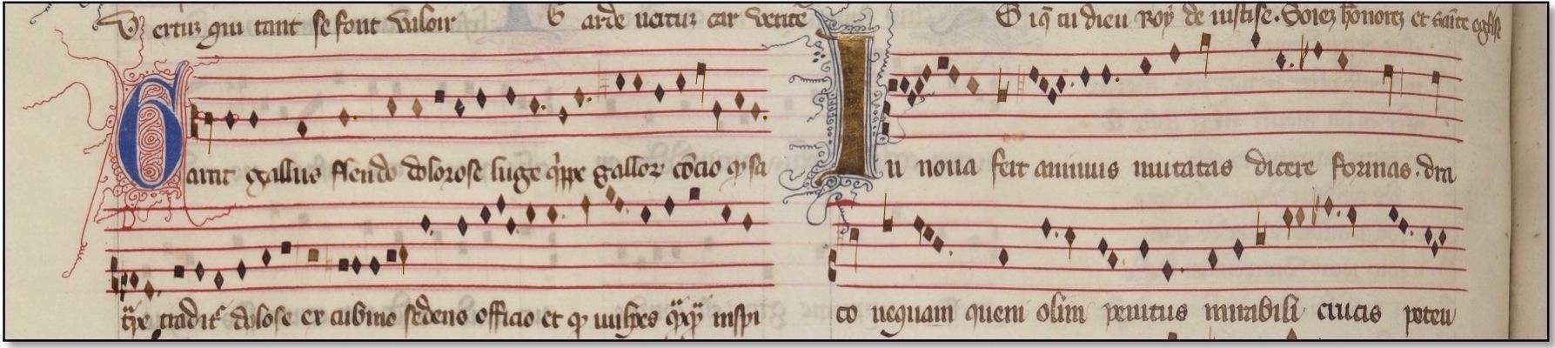
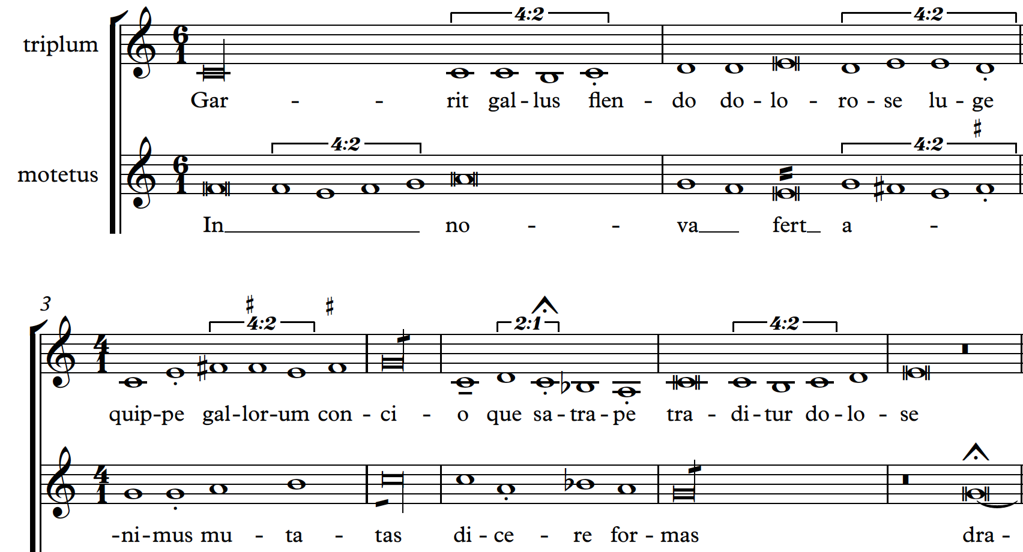
Opening of the motet Garrit gallus / In nova from the manuscript Paris, Bibliothèque nationale, f. fr. 146.
Notes:
HACK
Does not mean anything
Is a way to enter metadata into the file
Richard Freeman?

Slide 15
Repertoire for first phase of ‘Measuring Polyphony’ project
64 polyphonic motets representing:
Ars antiqua (c. 1280–1320):
Montpellier Codex (Montpellier, Bibliotheque interuniversitaire, Section de medecine, H. 196)
Roman de Fauvel manuscript (Paris, Bibliotheque nationale, f. fr. 146)
Brussels rotulus (Brussels, Bibliotheque royale, Ms. 19606)
Ars nova (c. 1320–1350):
Ivrea Codex (Ivrea, Biblioteca capitulare, Ms. 115)

Slide 16
Step 2: Convert into MEI
Sibelius
file
(modern transcription)
CMN
MEI
file
SibMEI
plugin

Slide 17
Step 3: The Mensural MEI Translator
CMN
MEI
file
Mensural
MEI
file
Mensural MEI
Translator

Slide 18
Four actions
Removes measure-related information
Substitutes the CMN articulation marks with the appropriate mensural notation element (or attribute), according to the standards developed by the MEI
Changes the CMN note names to the corresponding mensural note names
Determines and encodes the quality (perfect / imperfect) of the note within the <note> element
Notes:
The last two are related with capturing the note-shape and note-duration information.
The third refers to the note shape
The fourth refers to the duration of the note

Slide 19
Remove measure-related information
The CMN MEI <measure> elements were removed
The measure-rest <mRest> elements were substituted by <rest dur = “longa”>
Notes:
The measure-rest <mRest> elements were substituted by <rest> elements with the attribute @dur = “longa”, since all pieces are barred by the long.

Slide 20
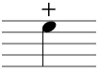
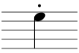
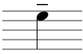
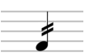
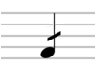
2. Substitutes the CMN articulation marks with the appropriate mensural notation element (or attribute)
Mensural feature | Sibelius | CMN MEI | Mensural MEI
Alteration |  | @artic = “stop” | @num = “1” @numbase = “2”
Dots |  | @artic = “stacc” | <dot>
Downward stem (major semibreves) |  | @artic = “ten” | @stem.dir = “down”
Plica upward |  | @stem.mod = “2slash” | @plica = “asc”
Plica downward |  | @stem.mod = “1slash” | @plica = “desc”
Sibelius
file
CMN MEI
file
Mensural MEI
file
Notes:
The last three Mensural MEI elements, the ones encoding the ‘downward stem’ and the ‘plicas’, are not included in the Mensural MEI module.
So these stems and plicas would not be rendered in Verovio, but their presence is encoded in the Mensural MEI file.
We are actually proposing these attributes to encode these mensural notation features.
* Even though the downward stem would not be shown in the display of the mensural piece, its effect (making the semibreve major, i.e., longer) will.

Slide 21







3. Changes the CMN note names to the corresponding mensural note names
CMN MEI @dur value | Mensural MEI @dur value | Mensural MEI @dur value (if ‘+’)
“long” | “longa” | “brevis”
“breve” | “brevis” | “semibrevis”
“1” | “semibrevis” | “minima”
“2” | “minima” | “semiminima”
“4” | “semiminima” | -
Perfect → Imperfect
Alteration
x 2

Slide 22
4. Determines and encodes the quality of the note within the <note> element
The quality values (relates to the realized durations) are:
Perfect
Imperfect
Altered
Minor and major semibreves (Ars antiqua)
Partial imperfection (Ars nova)
Notes:
[last two items] This is why we treat the two repertoires separately - here are some more details on this:

Slide 23
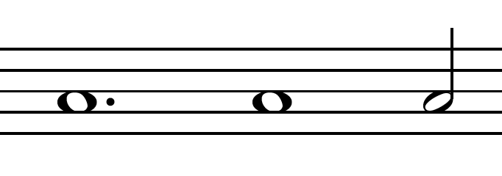
4. Determines and encodes the quality of the note within the <note> element
To encode the quality of the note:
Use the performed duration (encoded in the @dur.ges attribute) of the note to determine its perfect / imperfect quality
Then, mensuration is used to determine whether the perfect / imperfect value, is the default value or an “exception”
In case of an “exception” value, the quality of the note is encoded by using the @num and @numbase attributes
P
I
@dur.ges values
1536p
1024p
512p
Notes:
[last item] They define a ratio, by which the value by default must be multiply
THAT IS ENCODED IN RATIO THAT MULTIPLIES THE DEFAULT VALUE TO CHANGE IT TO THE MODIFIED VALUE (in case of an imperfection that fraction is ⅔, for example). THE FRACTION IS ENCODED IN THESE NUM AND NUMBASE ATTRIBUTES.

Slide 24
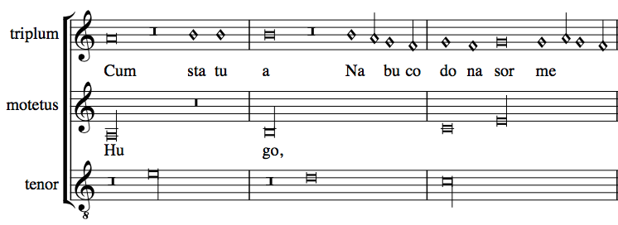
Examples: Imperfect, Altered, Perfect
Piece: Hugo
(Ivrea)
Verovio (Mensural)
Notes:
IN THIS PIECE THE LONG IS PERFECT BY DEFAULT
It is barred so that it can be easy to visualize where the perfections are
This long here, is perfect
THIS LONG DOES NOT OCUPY THE SAME SPACE
IT HAS THIS BREVE REST IN FRONT OF IT, THAT FORCES IT TO CHANGE ITS DEFAULT VALUE. IT IS IMPERFECT
2 BREVES BETWEEN LONGS → THE SECOND ONE GETS ALTERED (TWICE ITS VALUE)
And you can see that this altered breve occupies the same space as the imperfect long (because both of them are worth the same, even when they are two different notes)
So, as you can see, all the different three qualities of the notes: perfect, imperfect, and altered, are captured in the Mensural MEI file.

Slide 25
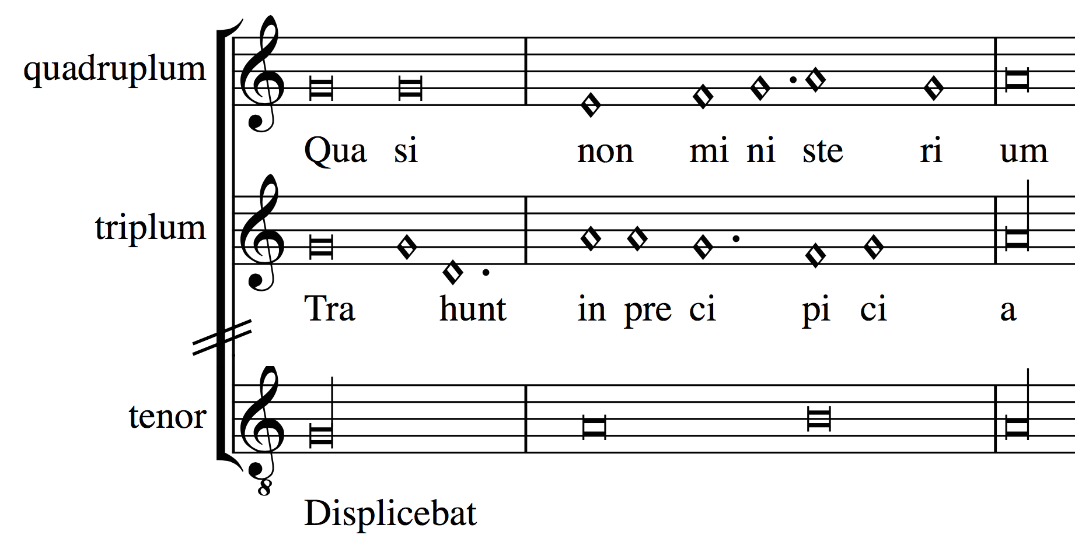
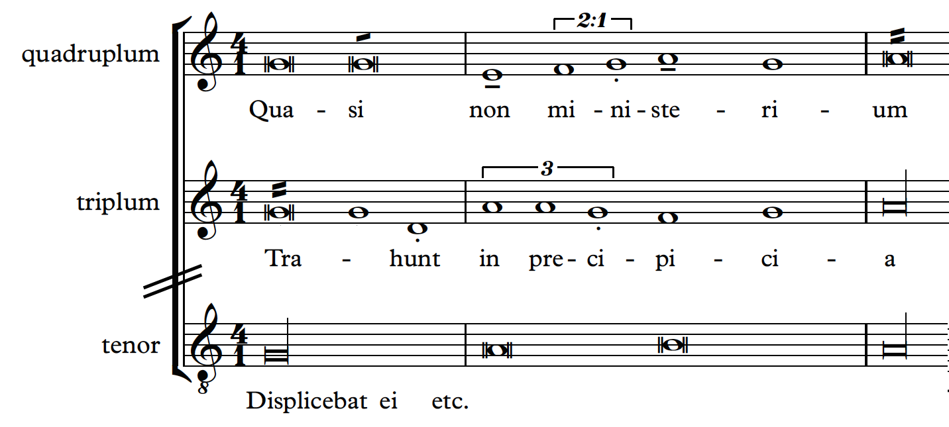
Examples: Minor and Major Semibreves
In ars antiqua pieces
Piece: Ve qui gregi
(Fauvel)
Verovio (Mensural)
Sibelius (CMN)
Notes:
Between the dots ←→ Breve
The dots divided the semibreves into groups that were equivalent to a single breve
Look at this 3 semibreves between the dots,
They are aligned to the breve below
And also you will see that they are equi-spaced,
Because for this piece, the breve was divided into 3 equivalent semibreves.
In the case of groups of 2 semibreves, the two semibreves are not equivalent. The second one is longer and, thus, called major. While the second one is short and, thus, called minor.
So all pairs of semibreves are understood as a minor-major pair (short-long).
But if the composer wanted to reverse this order, so that the first semibreve would be the long one (the major one), he had to draw a downward stem in it to indicate that that semibreve should be considered the major (longer) semibreve of the pair.

Slide 26
Mensural MEI Translator
Python module
Parameters:
Piece
Style (Ars antiqua or Ars nova)
Mensuration of each voice
Notes:
This means that the translator can deal with voices with different mensurations
Out of the 64 pieces, 58 are completely translated into mensural values. We are currently working on implementing “coloration” and “changes in mensuration within a voice” to cover the whole set of pieces.

Slide 27
In Conclusion
Sibelius
file
(modern transcription)
CMN
MEI
file
Mensural
MEI
file
SibMEI
plugin
Mensural MEI
Translator
MusicXML
PDF
Printed editions
MIDI
Notes:
The most long part is getting the modern transcription into sibelius and editing it (artic marks)
But this can also be made faster by…
Then everything is performed by the machine.
Comment I did that with JRP (MusicXML)
I also used MIDI files from ChoralWiki
And some of the pieces were obtained from printed modern editions, scanned with the OMR Sibelius tool “PhotoScore”

Slide 28
In Conclusion
Streamlines the process for digitally encoding this repertory
Encodes the original medieval notation in a standardized machine-readable format
Searched or analyzed
Available to other websites and applications
The pieces can be displayed in Verovio
Freely available to performers, scholars, and the public
Stay tuned for the ‘Measuring Polyphony’ website which will be launched in 2017/early 2018 http://www.measuringpolyphony.com
Notes:
1) streamlines the process for digitally encoding this repertory so that other stakeholders can easily and rapidly enlarge the dataset;
2) encodes the original medieval notation in a standardised machine-readable format so that it can be searched or analysed, and, through the interoperable format make this project’s data available to other websites and applications; and
3) the pieces can be displayed in Verovio, providing access to scored-up versions of this repertoire that retain the mensural notation features of the original manuscript sources, making them freely available to performers, scholars, and the public.
Most of the current encoding projects on early focus on repertories of plainchant (Cantus), or record repertories in modern notation formats (The Josquin Research Project). ‘Measuring Polyphony’ is the first project that encodes medieval music as it was originally notated, BY USING THIS METHODOLOGY
THE TRANSLATOR ITSELF IS INDEPENDENT OF SIBELIUS, IT CAN WORK WITH MODERN TRANSCRIPTIONS ENCODED IN CMN MEI (GIVEN THAT THEY FOLLOW PROF. DESMOND’S CONVENTIONS)

Slide 29




Thank you!
https://github.com/DDMAL/CMN-MEI_to_MensuralMEI_Translator

